Slide 1

SAP BTP ABAP on Cloud / RAP Training
DAY-14
Anubhav Oberoy
www.AnubhavTrainings.com
Follow excellence with sheer passion

Slide 2


DISCLAIMER
The training content and delivery of this presentation is confidential, and cannot be recorded, or copied and distributed to any third party, without the written consent of Anubhav Trainings

Slide 3

01
Authorization
02
Pre-Check
03
Augment
04
Virtual Elements
Notes:
https://pixabay.com/photos/san-francisco-transamerica-pyramid-1633203/

Slide 4
Authorization
Authorization control in RAP protects our business object against the unauthorized access of data. Authorization control is always relevant when the permission to execute an operation depends on a role of BO consumer. In the RAP, each read or modify request can be checked via authorization object against the user role before the request is finally executed and reaches data.
The auth check with auth object is called from cds entities in case of read request – was covered in Anubhav trainings abap on hana course
And behavior implementation in case of modify request
Global authorization
Global authorization is used for all authorization checks that only depends on the user.
Global authorization checks can be implemented both for static and instance bound operations
Instance authorization
Instance authorization is used for all auth checks that, in addition to the user role, depend on the state of the entity instance in question (like exact record level). Its only possible for instance based operation
Operations that are executed from instance auth are CREATE and static actions
Use case: when a user tries to edit a travel request, if the travel request status is cancelled, then we need to check that if he/she is a manager or not. Only managers can edit a cancelled travel request. Since each travel request is different, we need to go with instance-based authorizations.
www.anubhavtrainings.com

Slide 5
Prechecks
While the system is saving the draft in the draft table we can use prechecks to make sure that checks/authorizations are checked in the system before data reaches to draft table. Unlike validations (while saving/updating data to main table) Prechecks will trigger before data reaches to transaction buffer.
They are very helpful when we even want to validate data of one control based on another control. Currently as a developer you need to take additional pain to clean the data when draft is activated. If you apply precheck, system ensures that only the clean data reaches to transaction buffer.
Get The Country of Customer
Get The Country of Agency
www.anubhavtrainings.com

Slide 6
Augment
Before data reaches to transaction buffer, the augment code will be executed and here we can set some default data to the BO instance.
www.anubhavtrainings.com

Slide 7
Virtual Elements
There is a requirement to expose extra elements out of cds entities for which there is no data inside the database, basically these element values are calculated at runtime (on-fly). If you worked with SAP UI5 development, we have similar concept called formatter. We have a implementing class in which we will add our code for calculating the runtime data of virtual elements.
Rules:
We should only add them to projection view. Because if you add in main view, your draft table will disturb and your main table will never have these column.
RAP does not support filtering and sorting of virtual elements, also the aggregation and group is not allowed
We cannot select data from virtual elements using direct SELECT or EML
We have to write implementation in a class for virtual element that class must use the interface IF_SADL_EXIT_CALC_ELEMENT_READ.
www.anubhavtrainings.com

Slide 8
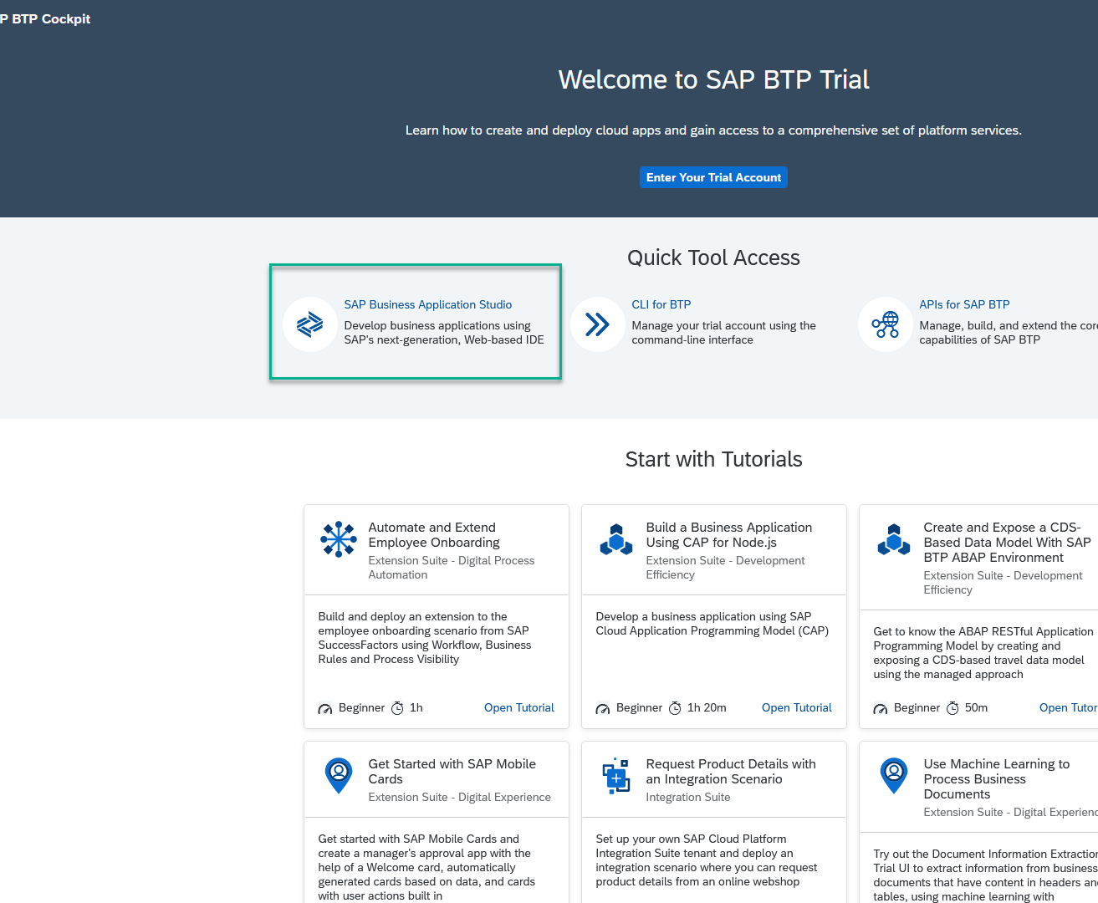
Business Application Studio
SAP Business Application Studio is a development environment available on SAP Business Technology Platform. It is a multi cloud development environment to create different kinds of Apps like HANA Native, CAPM, Fiori, MDK etc. A developer must create private dev space in the system in order to build application in BAS tool, All the required tooling is pre-configured in BAS.
In an Enterprise Account you can set up SAP Business Application Studio as a Free-Tier service by checking its free plan during its entitlement configuration.

Slide 9
Dev Space in BAS
We don’t want a single developer to consume all the available resources
We want a clear isolation of one developer with another
Pre-configured by sap for specific development
Solution - Virtualize
Dev Space
Dev Space
Dev Space
SAP BAS – Business App Studio
SAP BTP – Platform as a Service
IaaS – Infrastructure as a Service

Slide 10
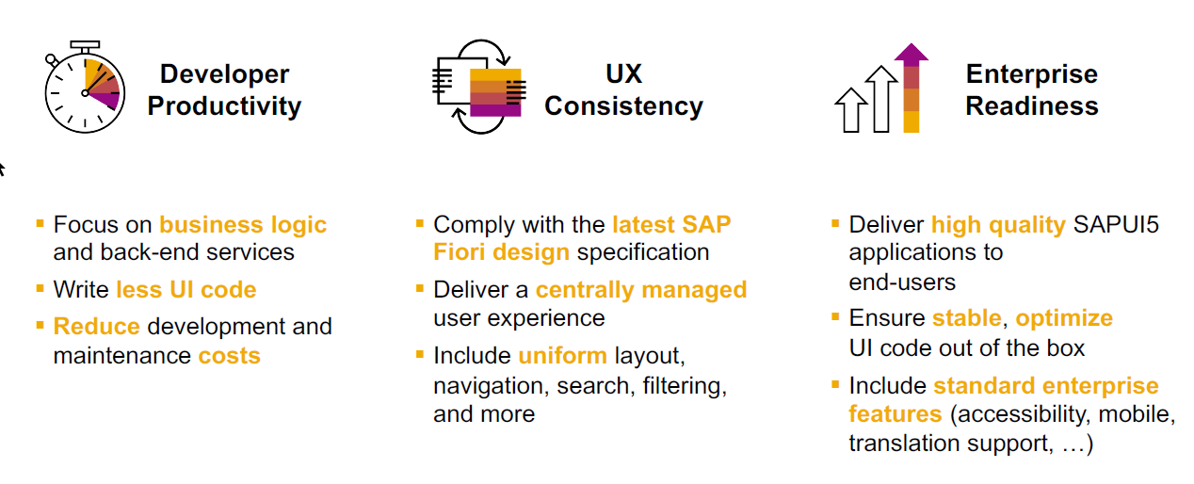
SAP Fiori elements boosts SAP Fiori development efficiency

Slide 11
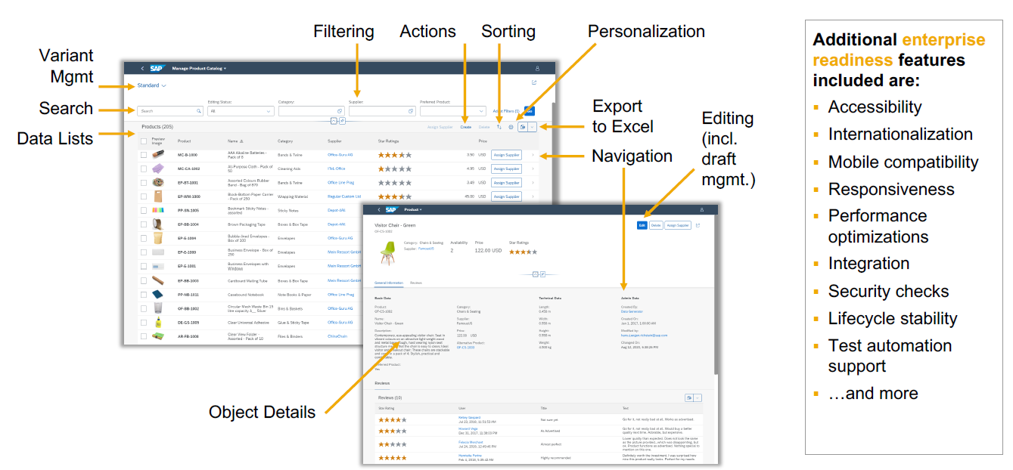
SAP Fiori elements provides enterprise-ready apps out of the box

Slide 12
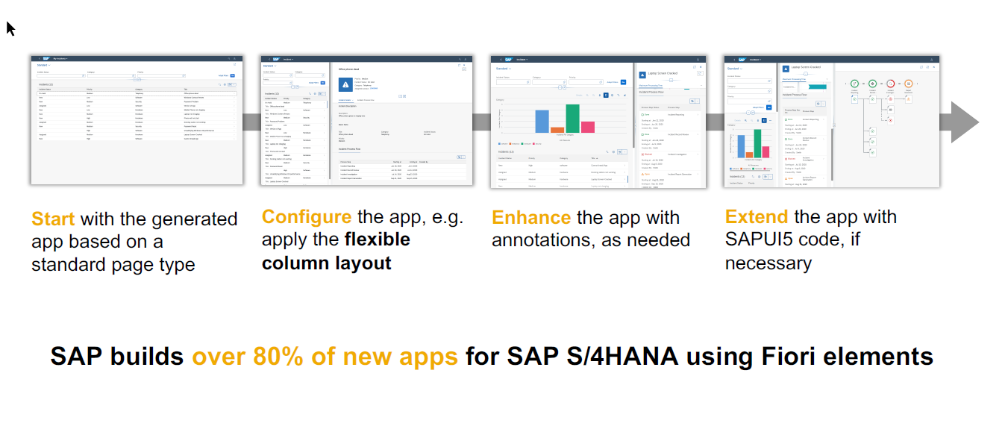
SAP Fiori elements application architecture provides flexibility

Slide 13
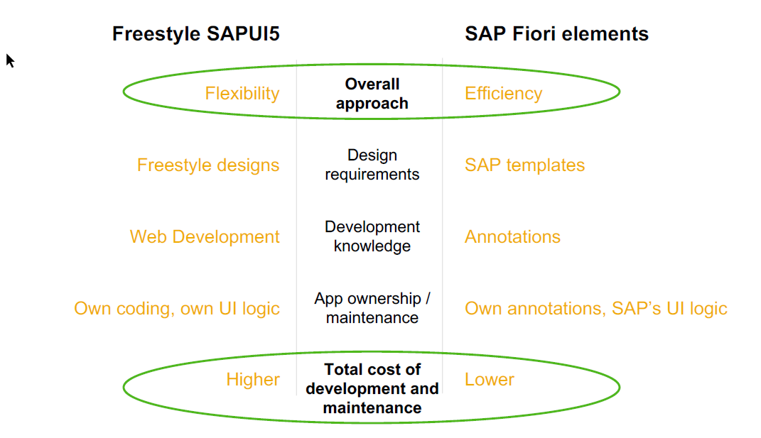
SAP Fiori elements prioritizes efficiency over flexibility

Slide 14
www.anubhavtrainings.com
Thank You
End of Day 14
www.anubhavtrainings.com

Slide 15


We’re committed to empower you to be
#FutureReady
through powerful training solutions.
We build the workforce of the future.
250+
Corporate Clients
30,000+
Learners Trained
25000+
Learners Placed
FREE WEBINARS
Sign up for free webinars with industry experts every fortnight!
Enroll Now!
Contact us today!
https://anubhavtrainings.com

